Slide 1
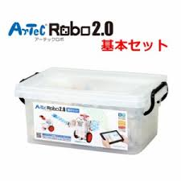
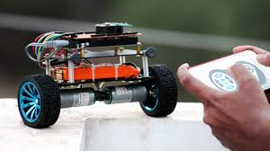
Artec Robo

Slide 2
System Requirements
Item Specifications
OS Windows XP (SP2 or later) / Vista / 7 / 8 / 8.1, Mac OS X
Processor (CPU) Pentium 4, 2 GHz or higher (or equivalent) recommended
Memory 256 MB or higher
USB USB2.0 port
Software Microsoft .NET Framework 4.0 required (automatically installed with the Studuino software)
Display XGA (1024×768) or higher

Slide 3
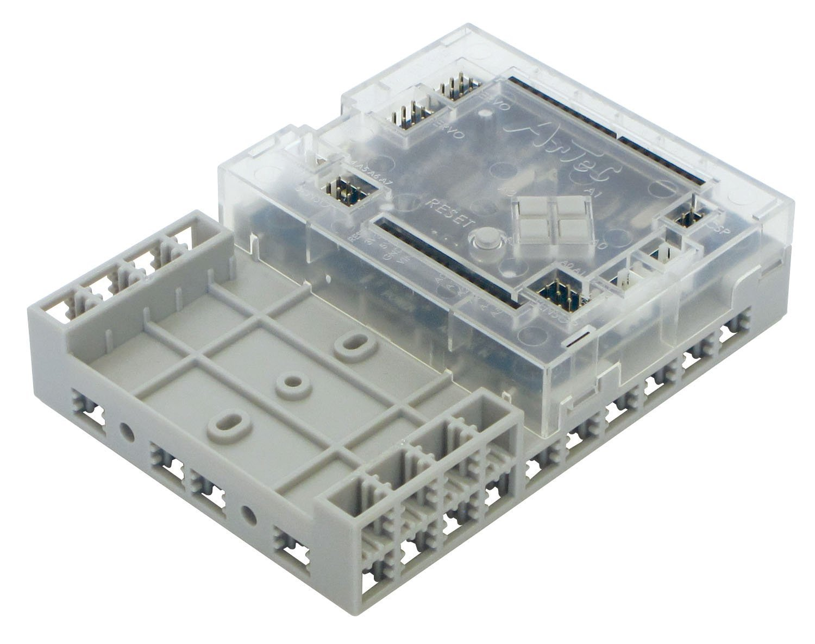
Studuino

Slide 4
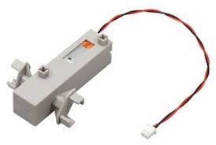
DC Motor connectors
These connectors are for DC Motors. Up to two DC Motors can be connected. The connector names are M1 and M2.

Slide 5
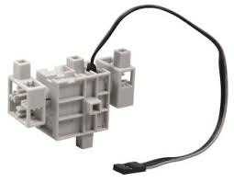
Servomotor connectors (multiple-pin digital connector)
* These connectors are for Servomotors. Up to 8 motors can be connected.
* The connector names are D2, D4, D7, D8, D9, D10, D11, and D12.

Slide 6
Reset switch
This switch resets the board.
Press this switch to restart Studuino when it is initialized
but does not operate properly or the PC does not recognize it.

Slide 7
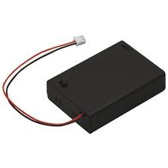
Power supply connector
* Connects to a power source. Sensors/LEDs/Buzzers/switches can use voltage supplied by USB, but DC Motors and Servomotors require power from the power jack.
* Connect a battery box to the power jack when USB is disconnected.

Slide 8
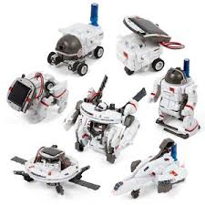
Thank you

